Slide 1
B.TECH CSE with Specialization in DevOps
Advanced Linux
Monitoring in Linux
Notes:
Notes to the Facilitator:
Welcome the participants and give them an overview of the module. Tell them that they will learn about the ‘Monitoring in Linux’ in this module.
Notes to the Participants:
You will be discussing about ‘Monitoring in Linux’ in this module.

Slide 2
Module Objectives
At the end of this module, you will be able to:
Provide an overview of Linux monitoring
Identify different metrics that are available for Linux monitoring
Explain the important built-in monitoring tools available in Linux
Discuss third party monitoring tools available for Linux performance monitoring
Notes:
Notes to the Facilitator:
Explain the module objectives to the participants.
Notes to the Participants:
You will be informed about the module objectives.
At the end of this module, you will be able to:
Provide an overview of Linux monitoring
Identify different metrics that are available for Linux monitoring
Explain the important built-in monitoring tools available in Linux
Discuss third party monitoring tools available for Linux performance monitoring

Slide 3
Module Topics
Let us take a quick look at the topics that we will cover in this module:
Introduction to Linux Monitoring
Linux Monitoring Metrics
Linux Built-in Monitoring Tools
Third Party Monitoring Tools
Notes:
Notes to the Facilitator:
Inform the participants about the topics that they will be learning in this module.
Notes to the Participants:
You will learn about the following topics in this module:
Introduction to Linux Monitoring
Linux Monitoring Metrics
Linux Built-in Monitoring Tools
Third Party Monitoring Tools

Slide 4
1.1 Introduction to Monitoring in Linux
Monitoring is done to check and maintain the health of Linux servers.
The major goal of monitoring is to understand the changes that happen to the environment, so that immediate action can be taken.
With proper monitoring tools and metrics, performance of the system can be improved.
Some of the benefits of Linux monitoring include:
Checking the availability of an application for a given number of users
Tracking of tool deployment
Operating system update behavior
Purchase requests
Exchanges or hardware upgrades
Notes:
Notes to the Facilitator:
Give the participants an overview of Linux monitoring and the benefits of monitoring Linux.
Notes to the Participants:
For the proper functioning of any system, it has to be monitored constantly, so that any change or defect in the system or its environment can be checked and fixed immediately. The main purpose of monitoring is to understand the changes that happen to the system, so that we can take immediate action.
The performance of the system can be improved by means of using proper monitoring tools and metrics. Improvements in the environment can also be suggested based on the monitoring history. There are multiple other purposes for monitoring, that include:
Checking the availability of an application for a given number of users
Tracking of tool deployment
Operating system update behavior
Purchase requests
Exchanges or hardware upgrades
It’s important to monitor the system to keep it up and running.

Slide 5
1.2 Linux Monitoring Metrics
There are four major categories of monitoring metrics:
1
Processor metrics
2
Memory metrics
3
Network interface metrics
4
Block device metrics
Notes:
Notes to the Facilitator:
List out the four categories of metrics used to monitor Linux performance.
Notes to the Participants:
There are many detailed analytical methods available to measure Linux system performance. The four major categories are as follows:
Processor metrics: Processor is the most important component of the computer system and it is very critical to monitor this metric for better system performance.
Memory metrics: Memory monitoring is important because it helps maintaining the functioning of the system by constantly monitoring the memory utilization and if there is any performance hit due to memory overflow.
Network interface metrics: Network performance is monitored as input and output of data packets and network performance logs also need to be monitored. According to the usage log, suitable plan for the application can be selected.
Block device metrics: Block device metrics generally refer to the measuring of I/O operations and relevant metrics.

Slide 6
1.2.1 Processor Metrics
The metrics that fall under processor metrics are as follows:
1
CPU utilization
2
User time
3
System time
4
Waiting
5
Idle time
6
Nice time
7
Load average
8
Runnable processes
9
Blocked processes
10
Context switch
11
Interrupts
Notes:
Notes to the Facilitator:
Explain the participants about the different metrics that fall under processor metrics.
Notes to the Participants:
Since processor is the most critical component of any system, a number of metrics are employed to measure the processor performance. The important metrics that come under processor metrics are as follows:
CPU utilization: CPU utilization tells us about the overall utilization per processor and is one of most straightforward metrics. For example, on IBM System x architectures, if the CPU utilization exceeds 80% for a considerable period of time, it indicates the possibility of a bottleneck.
User time: User time is a metric that describes the percentage of CPU spent on user processes, that is inclusive of the nice time. A high user time value indicates a better performance, because it indicates the time when the system actually performs.
System time: System time is the metric that describes the utilization of CPU on kernel operations, including IRQ and softirq time. Higher values of system time may indicate performance issues in the network and the driver stack. The kernel time should be as less as possible.
Waiting time: Waiting time is the time spent by the CPU on waiting for an I/O operation. High waiting time on I/O operations indicates performance bottlenecks like blocked value.
Idle time: Idle time describes the time period that the CPU stays idle while waiting for the tasks.
Nice time: This metric indicates the percentage of CPU spent on re-nicing the processes that modify the order of execution and the priority of the processes.
Load average: This metric is not expressed in terms of percentage. It is the rolling average of the sum of the following:
The number of processes in queue waiting to be processed.
The number of processes waiting for uninterruptible task to be completed.
This describes the average of the sum of TASK_RUNNING and TASK_UNINTERRUPTIBLE processes. Load average will increase, if the CPU does not have enough time to process the request. Similarly, the load will decrease when the requests sent by the processes are immediately responded by the CPU and there is no loss in the CPU cycles.
Runnable processes: Runnable processes are the ones that are ready to be executed. The value of runnable processes should not be more than 10 times that of the physical processors for a long time.
Blocked processes: This indicates the processes that cannot execute while waiting for an I/O operation to finish. These are also an indication of performance issues related to I/O.
Context switch: This metric describes the amount of switches between the threads. A higher value of context switches with interrupts indicates issues related to driver or application. Each of these context switches flush the CPU cache individually. Some amount of context switch is still necessary.
Interrupts: There are two types of interrupts, hard and soft interrupts. Hard interrupts have severe effects on system performance, high interrupt values indicate performance bottlenecks in the software, either in the kernel or in the driver. These interrupt values include the interrupts caused by the CPU block.

Slide 7
1.2.2 Memory Metrics
The different memory metrics are as follows:
1
Free memory
2
Swap usage
3
Buffer and cache
4
Slabs
5
Active versus inactive memory
Notes:
Notes to the Facilitator:
Explain the participants about the different types of memory metrics.
Notes to the Participants:
The different memory metrics are as follows:
Free memory: The value of free memory in Linux need not be seen as a metric of concern. In Linux, most of the unused memory is allocated as file system cache. For deriving the value of free memory, the value of buffers and cache need to be subtracted from the used memory.
Swap usage: Swap usage is the amount of swap space used. Swap usage is also a metric of measuring the efficiency of Linux in managing memory. The value of Swap In/Out is used as an identifier to memory bottleneck. Typically, values above 200 to 300 pages per second for a log time, indicates memory issues.
Buffer and cache: Refers to the cache that is allocated as file system and block device cache.
Slabs: This value indicates the memory utilized by kernel.
Active versus inactive memory: Active memory is the detail about the active use of system memory. The kswapd daemon can swap out the inactive memory to the disk.

Slide 8
1.2.3 Network Interface Metrics
Some of the network interface metrics are as follows:
1
Packets received and sent
2
Bytes received and sent
3
Collisions per second
4
Packets dropped
5
Overruns
6
Errors
Notes:
Notes to the Facilitator:
Explain the participants about the different network interface metrics.
Notes to the Participants:
Some of the network interface metrics are as follows:
Packets received and sent: Network interfaces send and receive packets of data. This metric is the quantity of packets sent and received by any given network interface.
Bytes received and sent: This is similar to the previous metric, refers to the number of bytes sent and received by a given network interface.
Collisions per second: This metric is the number of collisions that occur on the network to which the interface is connected to. Collision values for a long time may indicate an issue in the network interface, not the server. Collisions occur if the network infrastructure contains hubs, and are rare in networks that are configured properly.
Packets dropped: This value refers to the number of packets that are dropped by the kernel. The reason for this may be a firewall or lack of network buffers.
Overruns: Overruns indicate the number of times that the network interface ran out of buffer space. This is the value that should be used along with the packets dropped value, to identify the bottlenecks in the network buffers or length in network queue.
Errors: This value refers to the number of faulty frames. The reason for this could be a mismatch in a network or issue in the network cable. Broken network cables may indicate a performance issue for copper-based networks.

Slide 9
1.2.4 Block Device Metrics
Some of the block device metrics are as follows:
1
Iowait
2
Average queue length
3
Average wait
4
Transfers per second
5
Blocks read/write per second
6
Kilobytes per second read/write
Notes:
Notes to the Facilitator:
Explain the participants about the different block device metrics.
Notes to the Participants:
Some of the block device metrics are as follows:
I/O wait: Refers to the CPU utilized during the waiting for an I/O operation. High values of I/O for a long time may indicate an I/O issue.
Average queue length: Refers to the number of outstanding I/O requests. An optimal disk queue has a length of 2-3. Higher values may indicate an I/O bottleneck in the disk.
Average wait: This is the average time taken for servicing an I/O request and is measured in milliseconds (ms). The wait time is the actual I/O operation and the spent in waiting at the I/O queue.
Transfers per second: Represents the number of I/O operations per second. This value is used along with the kb/s value to measure the average size of the transfer in the system. This size should match the size of the stripe used by the disk subsystem.
Blocks read/write per second: This is the value of the number of reads and writes per second. For example, for in kernel 2.6 this metric is expressed as blocks of 1024 bytes. Earlier versions of kernels are associated with different block sizes.
Kilobytes per second read/write: This is the value of the reads and writes from/to the block and is represented in kilobytes. It is the representation of the actual data transferred to and from the block device.

Slide 10
What did You Grasp?
Which of the following metrics describes the percentage of CPU spent on user processes?
User time
System time
CPU utilization
Waiting time
Which of the following metrics refers to the memory utilized by kernel?
Buffer and cache
Slabs
Errors
Overruns
Notes:
Notes to the Facilitator:
Tell the participants that they will be going through a knowledge check question.
Answers:
1. a. User time
2. b. Slabs

Slide 11
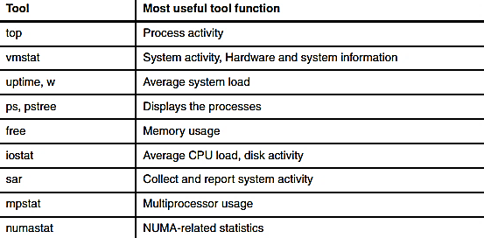
1.3 Linux In-built Performance Monitoring Tools
Linux has some command line tools for performance monitoring. Linux monitoring tools are displayed in the table below:
Tool
Most useful tool function

Slide 12
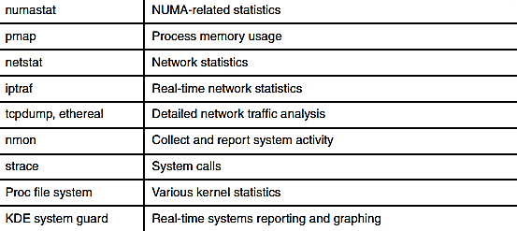
1.3 Linux In-built Performance Monitoring Tools (Contd.)
Tool
Most useful tool function
Notes:
Notes to the Facilitator:
Give the participants an overview of the in-built monitoring tools in Linux and list out the important monitoring tools and their function.
Notes to the Participants:
There are many command line tools in Linux that are used for performance monitoring. Many monitoring tools are shipped with the Linux distributions. Some tools deal with the metrics and give the output in an understandable way. Some tools are specific to some specific metric and produce detailed results.
The table above lists down the performance monitoring tools available in Linux. We’ll look at some of the performance monitoring tools now.

Slide 13
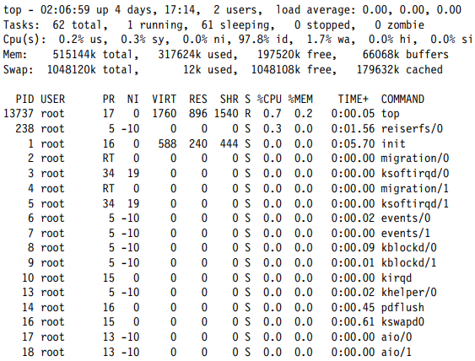
1.3.1 top
A sample output of the top command
Top command is one of the most important performance monitoring tool used commonly by many of the system administrators.
Top command lists all the running and active real-time processes as an ordered list.
Notes:
Notes to the Facilitator:
Explain the participants about the top command.
Notes to the Participants:
Top command is shipped along with many of the Linux and Unix-like systems and is the most frequently used performance monitoring tools used by many system administrators. Top command shows the actual process activity. It displays the CPU-intensive processes as an ordered list and the list is updated every 5 seconds. The listed processes can be sorted using PID, age, cumulative time and the resident memory usage and time (the time for which the process has occupied the CPU. The above screenshot shows a sample output of the top command. The output consists of the following columns:
PID - Process identification
USER - Name of the user who owns (and perhaps started) the process
PRI - Priority of the process
NI - Niceness level (Whether the process tries to be nice by adjusting the priority by the number given)
SIZE - Amount of memory (code+data+stack) used by the process in kilobytes
RSS - Amount of physical RAM used, in kilobytes.
SHARE - Amount of memory shared with other processes, in kilobytes
STAT - State of the process. The states are as follows: S=sleeping, R=running, T=stopped or traced, D=interruptible sleep, Z=zombie
%CPU - Share of the CPU usage (since the last screen update)
%MEM - Share of physical memory
TIME - Total CPU time used by the process (since it was started)
COMMAND - Command line used to start the task (including parameters)

Slide 14
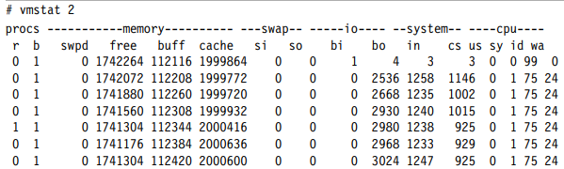
1.3.2 vmstat
vmstat is the command used to display the statistics of the virtual memory, kernel threads, I/O blocks, interrupts, CPU activity, etc.
vmstat is not a default command available in the Linux systems, sysstat package needs to be installed, that houses the vmstat command.
Sample output
Notes:
Notes to the Facilitator:
Explain the participants about the vmstat command.
Notes to the Participants:
The command vmstat is used to display the statistics like processes, memory, paging, block I/O, traps, and CPU activity. The vmstat command displays, either the average data or the actual samples. The sampling mode is enabled by providing vmstat with a sampling frequency and a sampling duration. A sample output of the vmstat command is shown in the screenshot above. The details of the columns are as follows:
Process (procs)
r: The number of processes waiting for runtime
b: The number of processes in uninterruptible sleep
Memory
swpd: The amount of virtual memory used (KB)
free: The amount of idle memory (KB)
buff: The amount of memory used as buffers (KB)
cache: The amount of memory used as cache (KB)
Swap
si: Amount of memory swapped from the disk (KBps)
so: Amount of memory swapped to the disk (KBps) IO
bi: Blocks sent to a block device (blocks/s)
bo: Blocks received from a block device (blocks/s)
System
in: The number of interrupts per second, including the clock
cs: The number of context switches per second CPU (% of total CPU time)
us: Time spent on running non-kernel code (user time, including nice time)
sy: Time spent on running kernel code (system time)
id: Time spent idle
wa: Time spent waiting for IO

Slide 15
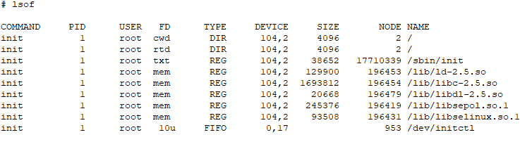
1.3.3 lsof
lsof command is used to list all the open files and processes.
The open files listed in the output are disk files, network sockets, pipes, devices and processes.
Sample output of the lsof command
Notes:
Notes to the Facilitator:
Explain the participants about the lsof command.
Notes to the Participants:
The lsof command is used in many Linux/Unix systems for displaying the list of open files and processes. The open files included in the list are disk files, network sockets, pipes, devices and processes. Once major scenarios where the lsof command is used is that when it is unable to unmount a disk because of the error that files are being open or used. Using this command, it is easy to identify the files that are in use.

Slide 16
1.3.4 uptime
This command is used to see the amount of time that the system has been running and the number of users logged in.
uptime command also tells us the overview of the average load of the server and it is displayed at intervals of the past 1 minute, 5 minutes, and 15 minutes.
This command is used to identify a problem with the server or the network.
Sample output of the uptime command
Notes:
Notes to the Facilitator:
Explain the participants about the uptime command.
Notes to the Participants:
The uptime command is used to see the amount of time that the server has been running and the number of users who are logged on. The command will also give us an overview of the average load of the server, which is displayed at intervals of past 1 minute, 5 minutes, and 15 minutes.
The ideal value of the server load is 1, which indicates that each process has immediate access to the CPU and there is no loss in CPU cycles. The load to the server varies from system to system. For a workstation with a single processor, the acceptable values are 1 or 2, whereas for multiprocessor servers, it can be in the range of 8 to 10.
Uptime is used to identify any bottleneck to the server or network. After running the command, if the system load is heavy, the issue is with the server. If it is not high, the issue is with the network.

Slide 17
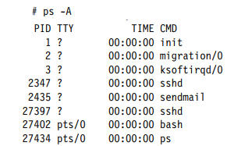
1.3.5 ps, pstree
These are some of the basic commands related to system analysis.
The ps command lists the existing processes along with more details, compared to the top command.
The pstree command lists the running processes in a tree structure and consolidates the spawned subprocesses.
A sample output of the ps command
Notes:
Notes to the Facilitator:
Explain the participants about the ps and pstree commands.
Notes to the Participants:
The ps and pstree commands are the most commonly used basic commands for system analysis. There are three types of command options for ps, Unix style, BSD style and GNU style.
The ps command provides a list of running processes, but compared to the top command, ps offers a more details about the processes. For example, a simple ps -A command, as shown in the screenshot above, will list all the processes along with their process ids (PIDs). For cases in which it is difficult to see a complete picture of the running processes, we can use the pstree command for a more organized view. It also helps in identifying the originating processes. pgrep is also a variant of ps. In the more detailed output of ps command, the following columns will be present:
F - Process flag
S - State of the process: S=sleeping, R=running, T=stopped or traced, D=interruptible sleep, Z=zombie
UID - Name of the user who owns (and perhaps started) the process
PID - Process ID number
PPID - Parent process ID number
LWP - LWP (light weight process, or thread) ID of the lwp being reported
C - Integer value of the processor utilization percentage (CPU usage)
NLWP - Number of lwps (threads) in the process (alias thcount)
PRI - Priority of the process
NI - Niceness level
ADDR - Process Address space (not displayed)
SZ - Amount of memory (code+data+stack) used by the process in kilobytes
WCHAN - Name of the kernel function in which the process is sleeping
RSS - Resident set size, the non-swapped physical memory that a task has used (in kiloBytes)
PSR - Processor that process is currently assigned to
STIME - Time the command started
TTY - Terminal
TIME - Total CPU time used by the process (since it was started)
CMD - Command line used to start the task (including parameters)

Slide 18

1.3.6 free
To know the total amount of the free and used memory, the /bin/free command is used.
The command also provides information on the buffers and cache used by the system.
Sample output of /bin/free command
Notes:
Notes to the Facilitator:
Explain the participants about the free command.
Notes to the Participants:
The /bin/free command is used to know the total amount of free and used memory, which also includes the information on buffers and cache used by the system. The amount of free memory is of limited use and utilization statistics alone may not indicate a memory bottleneck.

Slide 19
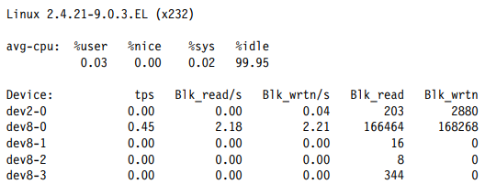
1.3.7 iostat
The iostat command shows the average CPU time, since the start of the system, and it is similar to the uptime command.
The command also generates a report on the activities of the disk subsystem of the server as CPU utilization and disk utilization.
The iostat is also part of the sysstat package.
A sample output of iostat command
Notes:
Notes to the Facilitator:
Explain the participants about the iostat command.
Notes to the Participants:
The iostat command shows the average CPU time since the start of the system like the uptime command. The command also generates a report on the activities of the disk and there are two parts of this report, CPU utilization and disk utilization. The columns in the CPU and disk utilization are as follows:
CPU utilization report
%user - Percentage of CPU utilization that was taken up while executing at the user level (applications).
%nice - Percentage of CPU utilization that was taken up while executing at the user level with a nice priority.
%sys - Shows the percentage of CPU utilization that was taken up while executing at the system level (kernel).
%idle - Shows the percentage of time the CPU was idle.
Disk utilization report
Device - The name of the block device.
tps - The number of transfers per second (I/O requests per second) to the device. Multiple single I/O requests can be combined in a transfer request, because a transfer request can have different sizes.
Blk_read/s, Blk_wrtn/s -
Blocks read and written per second indicate data read from or written to the device in seconds.
Blk_read, Blk_wrtn - Total number of blocks read and written since the boot.

Slide 20
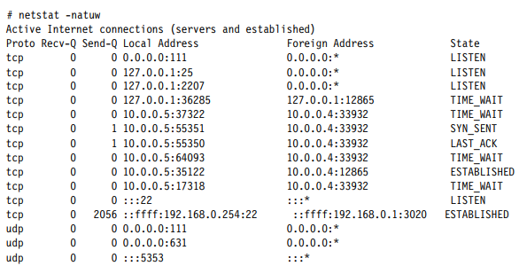
1.3.8 netstat
One of the most popular tools used while working on the network.
The details related to network are displayed using this command, including socket usage, routing, interface, protocol, network statistics, etc.
Sample output shows the socket information with the netstat command
Notes:
Notes to the Facilitator:
Explain the participants about netstat command.
Notes to the Participants:
netstat is one of the most popular commands used by administrators who work with the network. The netstat command displays the information related to the network, that includes socket usage, routing, interface, protocol, network statistics, etc. Some of the options for this command are as follows:
-a - Socket information
-r - Routing information
-i - Network interface statistics
-s - Network protocol statistics
The details of the columns in the output of socket information using the netstat command are as follows:
Proto - The protocol (tcp, udp, raw) used by the socket
Recv-Q - The count of bytes not copied by the user program connected to this socket
Send-Q - The count of bytes not acknowledged by the remote host
Local Address - Address and port number of the local end of the socket
Foreign Address - Address and port number of the remote end of the socket
State - The state of the socket

Slide 21
1.3.9 iptraf
The use of iptraf is to monitor the TCP/IP traffic real time and to generate the report.
Statistics of TCP/IP traffic status by session, interface and protocol. This tool is provided by the iptraf package.
The reports provided by iptraf command are as follows:
IP traffic monitor
General interface statistics
Detailed interface statistics
Statistical breakdowns
LAN station monitor
Notes:
Notes to the Facilitator:
Explain the participants about the iptraf command.
Notes to the Participants:
The command iptraf is used to monitor the traffic of TCP/IP real time and generate real time report. These data are generated by session, interface and protocol. The iptraf package provides the iptraf tool.
The reports provided by iptraf command are as follows:
IP traffic monitor - Network traffic statistics by TCP connection
General interface statistics - IP traffic statistics by network interface
Detailed interface statistics - Network traffic statistics by protocol
Statistical breakdowns - Network traffic statistics by TCP/UDP port and packet size
LAN station monitor - Network traffic statistics by Layer2 address

Slide 22
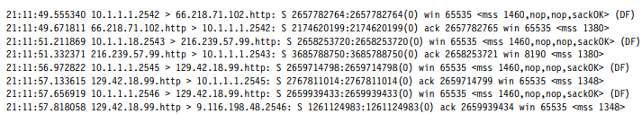
1.3.10 tcpdump and ethereal
The commands tcpdump and ethereal are used to capture and analyze network traffic.
The library commonly used by these tools for capturing the network details is libpcap library.
tcpdump can basically analyze the protocol and give a picture of the network.
ethereal also has a similar functionality, but it can perform more advanced analysis than tcpdump.
Notes:
Notes to the Facilitator:
Explain the participants about tcpdump and ethereal.
Notes to the Participants:
Both the command tcpdump and ethereal are used to capture and analyze network traffic. Both these tools are used to analyze network related bottlenecks. The libpcap library is used to capture the packets.
tcpdump: tcpdump is can perform basic analysis of the protocol and provide a report about the network. There are many options and expressions available in in tcpdump for filtering the frames to be captured.
Some of the filtering options are given below:
-i <interface> - Network interface
-e - Print the link-level header
-s <snaplen> - Capture <snaplen> bytes from each packet
-n - Avoid DNS lookup
-w <file> - Write to file
-r <file> - Read from file
-v, -vv, -vvv - Verbose output
Expressions for filtering are as follows:
Keywords:
host dst, src, port, src port, dst port, tcp, udp, icmp, net, dst net, src net, and more
Primitives may be combined using:
Negation (‘`!‘ or ‘not‘)
Concatenation (`&&' or `and')
Alternation (`||' or `or')
ethereal: ethereal functions in a way similar to that of the tcpdump command, but provides more advanced analytics than that of tcpdump. ethereal has a GUI and CLI for using the ethereal command. Like tcpdump, the capture filter can be used with the ethereal command also. Some of the expressions are as follows:
IP
TCP/UDP
Application

Slide 23
1.4 Other Monitoring Tools
Some of the other important built-in tools are as follows:
sar
for collecting, reporting and saving system activity information
mpstat
for reporting the activities of each of the available CPUs on a multiprocessor server
numastat
for getting information about the ratio of local versus remote memory usage and the overall memory configuration of all nodes
pmap
measuring the amount of memory that one or more processes are using
nmon
Nigel’s monitor - performance monitoring tool for measuring processor utilization, memory utilization, run queue information, disks I/O statistics, network I/O statistics, paging activity, process metrics, etc.
Notes:
Notes to the Facilitator:
Give an overview of the other useful monitoring tool in Linux.
Notes to the Participants:
We’ve so far seen about the important Linux monitoring tools. Other frequently used tools are as follows:
sar - for collecting, reporting and saving system activity information
mpstat - for reporting the activities of each of the available CPUs on a multiprocessor server
numastat - for getting information about the ratio of local versus remote memory usage and the overall memory configuration of all nodes
pmap - measuring the amount of memory that one or more processes are using
nmon - Nigel’s monitor - performance monitoring tool for measuring processor utilization, memory utilization, run queue information, disks I/O statistics, network I/O statistics, paging activity, process metrics, etc.

Slide 24
What did You Grasp?
Fill in the blank. The tool used to measure process memory usage ____.
sar
pmap
iptraf
Nmon
Which of the following tools is used to measure the average system load?
numastat
mpstat
uptime
strace
Notes:
Notes to the Facilitator:
Tell the participants that they will be going through a knowledge check question.
Answers:
1. b. pmap
2. c. uptime

Slide 25
What did You Grasp?
Say True or False. mpstat is used for monitoring CPUs in multiprocessor servers.
True
False
Notes:
Notes to the Facilitator:
Tell the participants that they will be going through a knowledge check question.
Answer:
3. a. True

Slide 26
2.1 Third Party Monitoring Tools
Apart from the built-in tools there are third party web-based tools that are available for Linux system monitoring. Some of the popular tools are as follows:
Nagios
Icinga
Third Party Monitoring Tools
Cacti
OpenNMS
Zabbix
Notes:
Notes to the Facilitator:
List out the important third party monitoring tools available for Linux system monitoring.
Notes to the Participants:
Apart from the built-in tools that are available for Linux monitoring. These tools can cover most of the monitoring tasks carried out by the system administrators. There are many third party monitoring tools which can display the monitoring results in a nice UI and many types of alert configuration is available.
Some of the web-based tools available for Linux system monitoring are as follows:
Nagios
Cacti
Zabbix
OpenNMS
Icinga

Slide 27
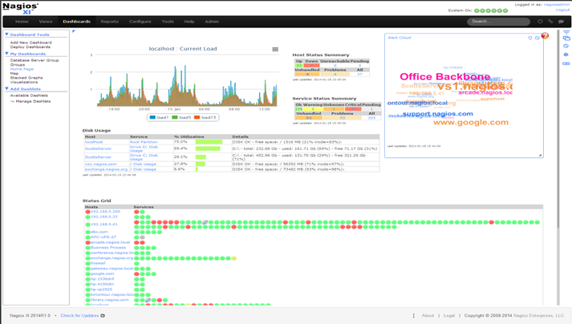
2.1.1 Nagios
Nagios is one of the most popular open source Linux monitoring tools licensed under GPL.
It is a comprehensive tool available to monitor availability and response time of network, utilization of system resources like CPU load, RAM allocation, number of logged in users, etc.
The sample screenshot from Nagios is given below:
Notes:
Notes to the Facilitator:
Explain the participants about the Nagios monitoring tool.
Notes to the Participants:
Nagios is one of the industry leaders in providing monitoring solutions for multiple levels of infrastructure. Nagios can monitor different types of components like network protocols, operating systems, system metrics, applications, services, web server, website, middleware, etc. It runs on a Core 4 monitoring engine, because of which it can offer a high level of performance by consuming fewer server resources. It can be integrated with almost any type of third-party software by using a plugin, and most of these plugins are already available.

Slide 28
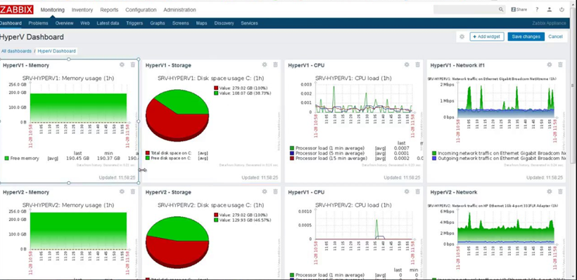
2.1.2 Zabbix
The figure shows the sample dashboard in Zabbix.
Notes:
Notes to the Facilitator:
Explain the participants about Zabbix.
Notes to the Participants:
Zabbix is an enterprise level software used for monitoring performance, availability of servers, network equipment, web applications, database, etc.
Zabbix is based on system-agent architecture and the agent has to be installed on a server to be monitored by Zabbix. We need not install the agents for services like FTP, SSH, HTTP, DNS, etc. Zabbix is not limited to Linux and can be installed in Windows, Solaris, MacOS X, etc., and can be integrated with other system management tools.

Slide 29
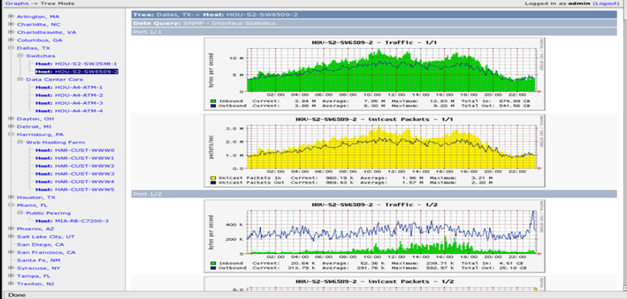
2.1.3 Cacti
Cacti is also an open source monitoring tool for Linux. The sample dashboard in Cacti is shown below.
Notes:
Notes to the Facilitator:
Explain the participants about Cacti.
Notes to the Participants:
Cacti is also an open source network monitoring tool that can be installed on Linux or Windows OS. Cacti is connected to another tool called RRDTool, that helps in generating graphs related to the network. Cacti works along with SNMP and helps to represent network statistics in the form of charts that can be easily understood. Cacti requires that the system has MySQL, Apache or IIS that supports PHP.

Slide 30
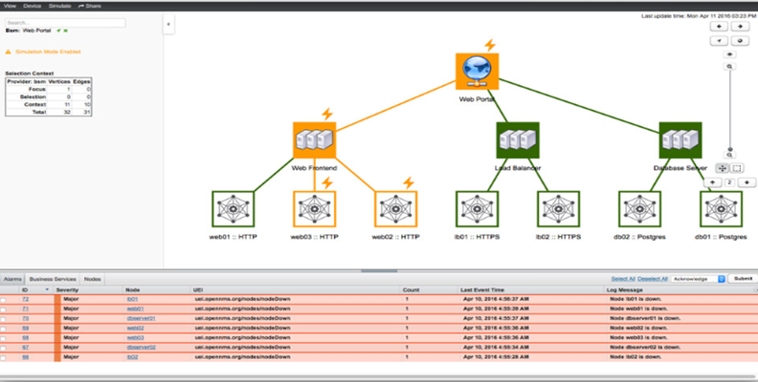
2.1.4 OpenNMS
The figure shows the sample screenshot from OpenNMS.
Notes:
Notes to the Facilitator:
Explain the participants about OpenNMS.
Notes to the Participants:
With OpenNMS, we can capture the metrics using JMX, WMI, SNMP, NRPE, XML, HTTP, JDBC, XML, JSON, etc. OpenNMS is built on an event-driven architecture. OpenNMS can also be installed in Docker containers and the report can be viewed in dashboards and charts. Though OpenNMS is designed for Linux specifically, it can also be installed in Windows, Solaris, MacOS X, etc.

Slide 31
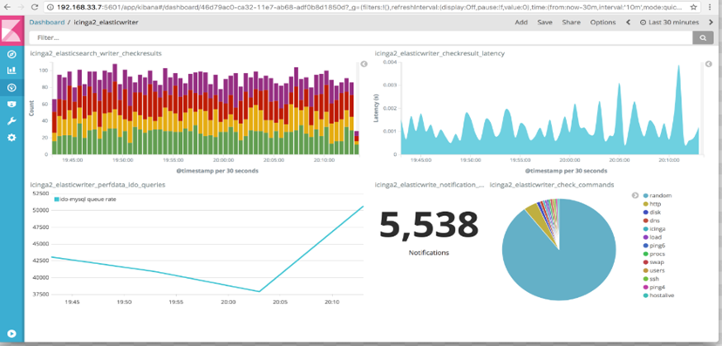
2.1.5 Icinga
The figure shows the sample dashboard in Icinga.
Notes:
Notes to the Facilitator:
Explain the participants about Icinga.
Notes to the Participants:
Icinga helps to monitor all the available systems in the network and also provides a database for the SLA reporting. Icinga can monitor network services, host services and server components. Icinga provides support for event handlers and notifications and it supports multiple operating systems. The important feature of Icinga is the parallelized service check that it can perform.

Slide 32
What did You Grasp?
Say True or False. Icinga supports only Linux.
True
False
Notes:
Notes to the Facilitator:
Tell the participants that they will be going through a knowledge check question.
Answer:
1. b. False

Slide 33
In a nutshell, we learnt:
Introduction to Linux monitoring
Different metrics available for Linux monitoring
The important built-in monitoring tools available in Linux
Third party monitoring tools available for Linux performance monitoring
Notes:
Notes to the Facilitator:
Share the module summary with the audience.
Ask the participants if they have any questions. They can ask their queries by raising their hands.
Notes to the Participants:
Now, you have reached the end of the module, In this module, you have learned:
Introduction to Linux monitoring
Different metrics available for Linux monitoring
The important built-in monitoring tools available in Linux
Third party monitoring tools available for Linux performance monitoring

